Slide 1

Indian Institute of Technology, Guwahati
CS570 Assignment 3 Presentation
Prepared By:
Neelesh K Shukla
The Crawlers
Dated: 19th November 2016
CS 570

Slide 2
Quick Recap of
Previous Assignments

Slide 3
Assignment 1 Gist
Purpose of this assignment was to evaluate effectiveness of IR system.
A small search engine was built using TFIDF and BM25 based retrieval.
Precision@10 measure was used for evaluation.
We concluded that mostly BM25 performs better than TF-IDF.

Slide 4
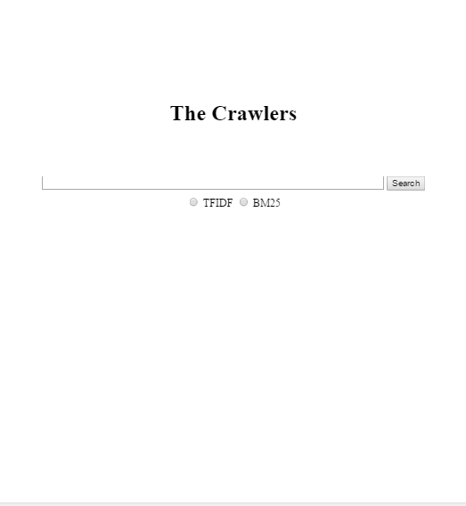
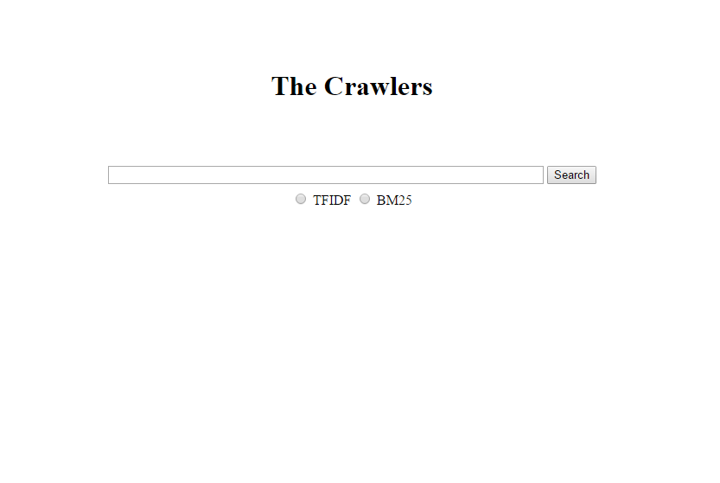
Assignment 1: The Crawlers’ Search Engine
Search Engine URL:
http://172.16.115.152:8080/SearchEngine
Indexer URL:
http://172.16.115.152:8080/TheCrawlersIndexer

Slide 5
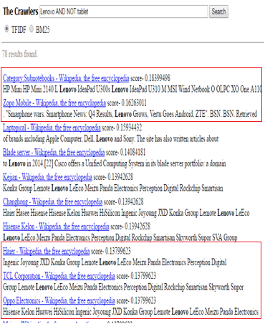
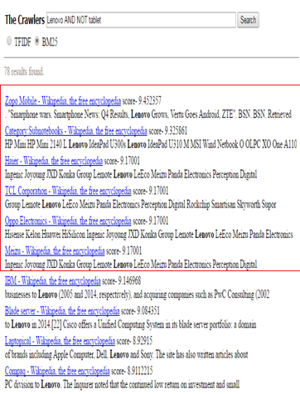
Assignment 1 - Screenshots
TF-IDF Result BM25 Result
TF-IDF P@10:
5/10
BM25 P@10:
6/10

Slide 6
Assignment 2 Gist
In this assignment we worked on structural contextual similarity measure called SimRank.
Our application used SimRank to provide searches related to the top result returned by BM25.
Cosine similarity was used to define relation between two documents, based on following assumptions.
  Two documents are similar if they are referred by document which has similar content.
  If two documents have similar content, they are somehow related to similar topics/areas.
We built assignment 2 on the top of assignment 1.

Slide 7
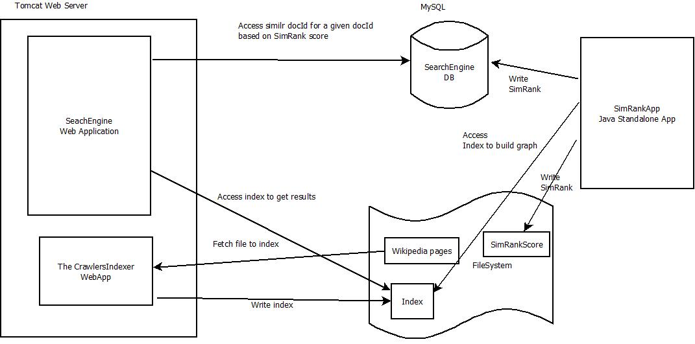
Assignment 2: System Overview

Slide 8
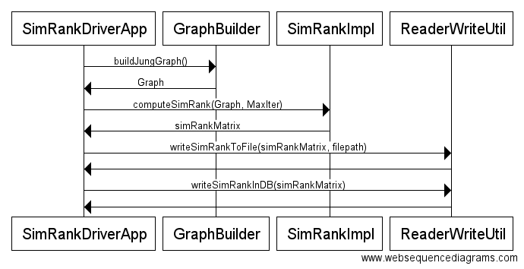
Assignment 2: SimRankApp Sequence Diagram

Slide 9
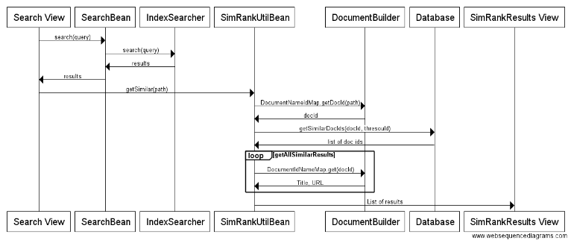
Assignment 2: Search Engine Sequence Diagram

Slide 10
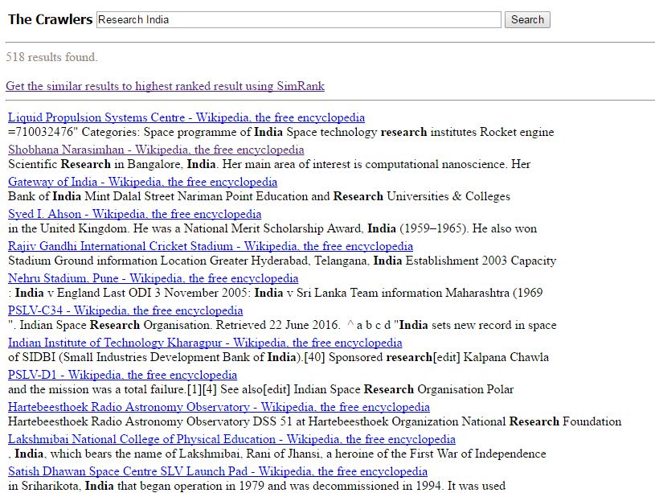
Assignment 2: Screenshots – Search Step 1

Slide 11
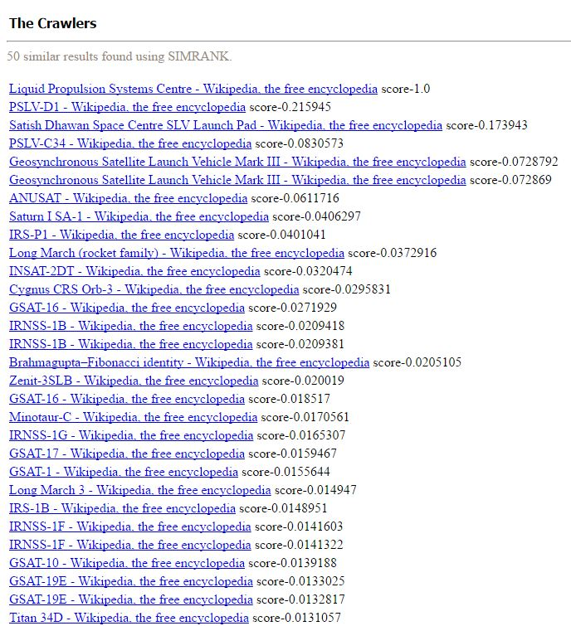
Assignment 2: Screenshots - Search Step 2

Slide 12
Assignment - 3

Slide 13
Assignment 3 : Directions ->
Use some API to improve search engine. (Application Development)
Take existing ideas and implement them to improve search experience.
Come up with own idea based on our previous observations and learning. Be it a small improvement.

Slide 14
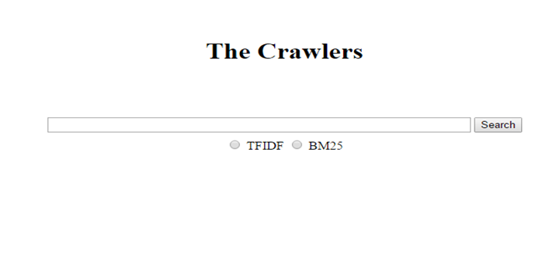
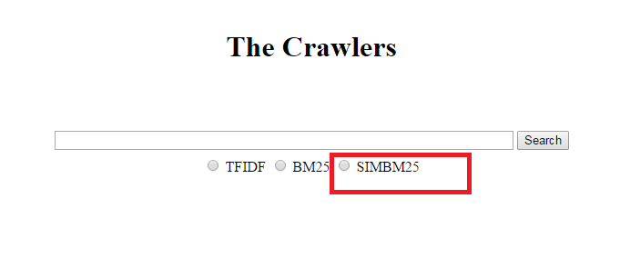

Assignment 3 : Improvements
Devised a new ranking function combining SimRank and BM25.

Slide 15
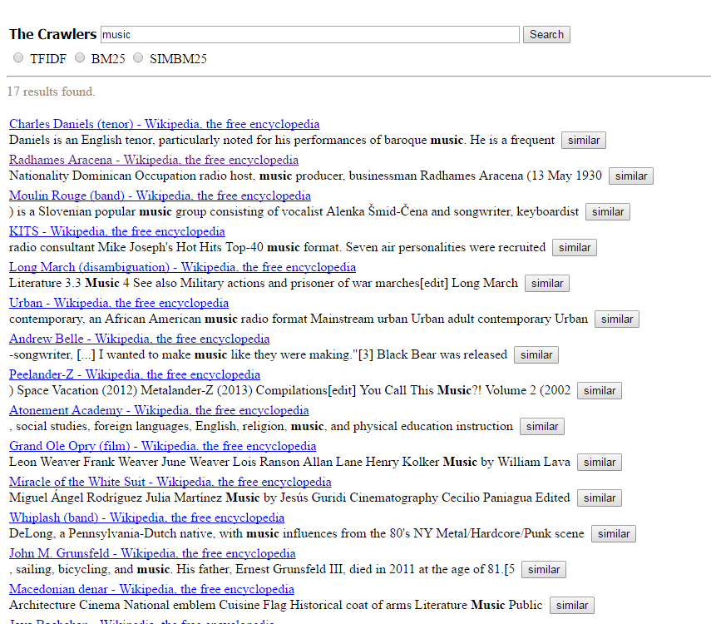
Assignment 3 : Improvements
Provided ‘Similar’ results feature for each result.

Slide 16
Assignment 3 : Improvements
Better UI for listing SimRank based Results.
2-Step search to 1-step search.

Slide 17

Proposed Ranking Function: SIMBM25
Structural contextual similarity plays role in understanding context.
In assignment 2, we fetched results using BM25 and taken the 1st results as a reference to get the query intent and listed pages similar to topmost result.
BM25 and SimRank score can be combined to improve search result.
We fetched new results which are similar to topmost BM25 result. If topmost result is biased then new search will be biased.
Use top K results of BM25 to calculate score.

Slide 18






Proposed Ranking Function: SIMBM25
Previous scoring function has a flaw.
Example
Both d1 and d2 got same score but d1 must be ranked higher than d2.
  Need to assign some weight to SimRankScore.

Slide 19
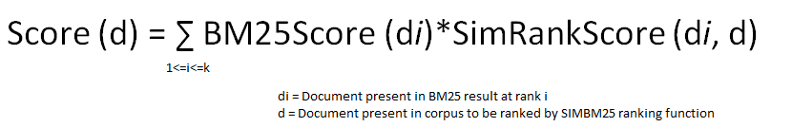
Proposed Ranking Function: SIMBM25
BM25 score of the documents was used as weight.
Final scoring function
  *This is online scoring mechanism, scores are calculated on the fly.

Slide 20
Precision@10 Evaluation

Slide 21
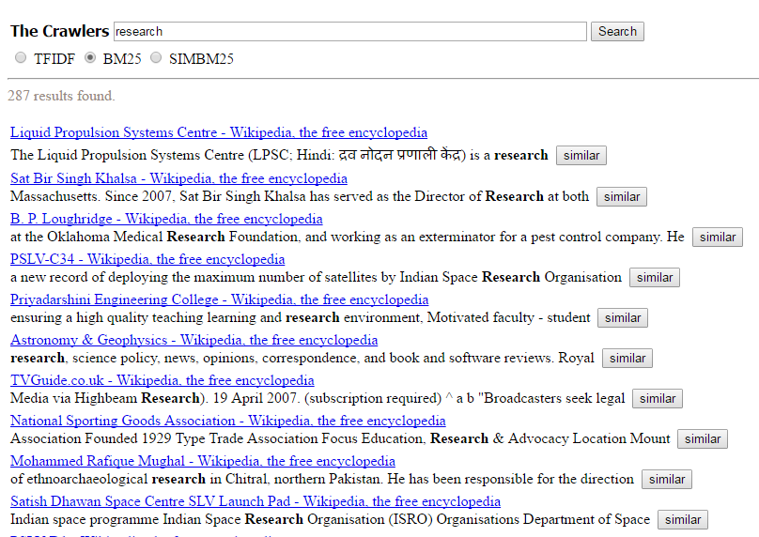
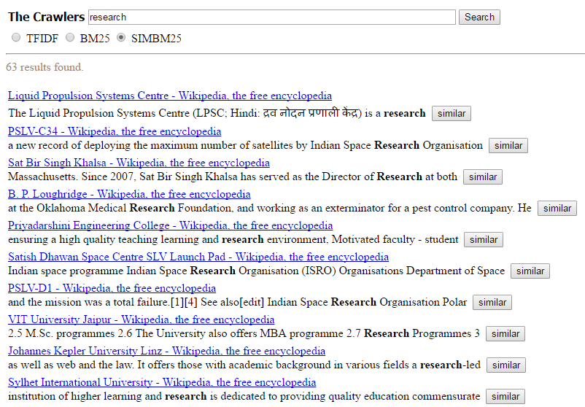
Query: Research
BM25 Result SIMBM25 Result
BM25:
4/10
SIMBM25:
6/10

Slide 22
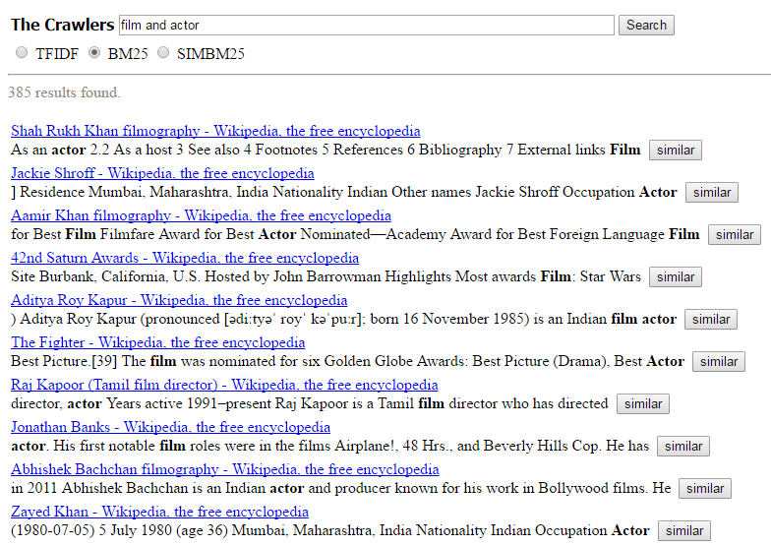
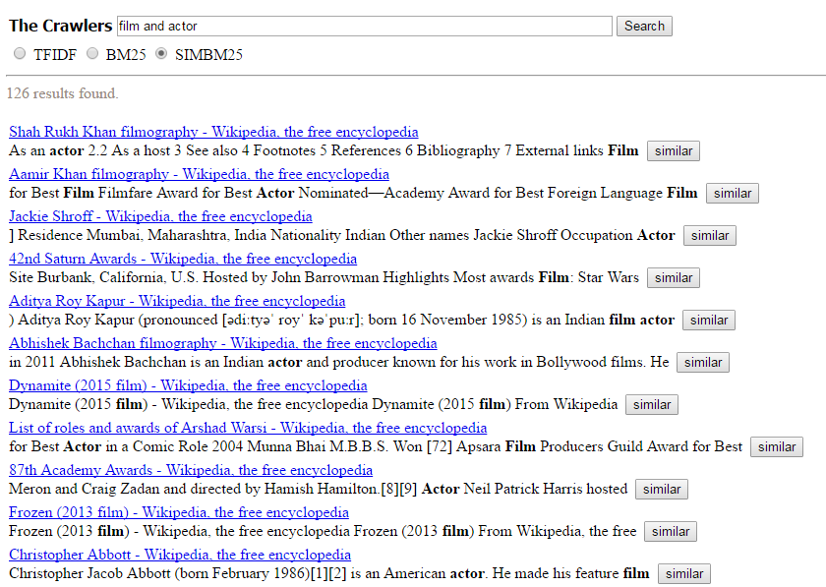
Query: Film and Actor
BM25 Result SIMBM25 Result
BM25:
6/10
SIMBM25:
6/10

Slide 23
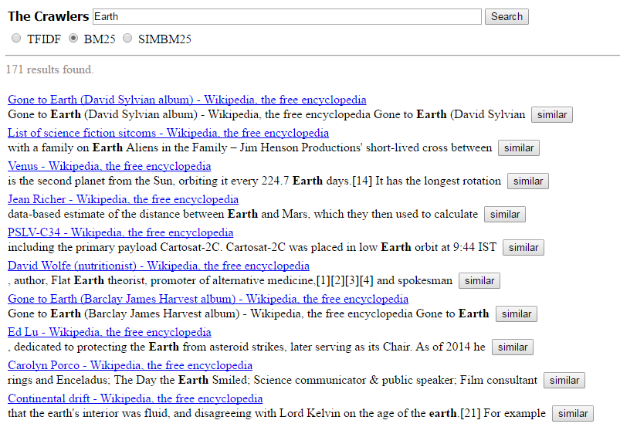
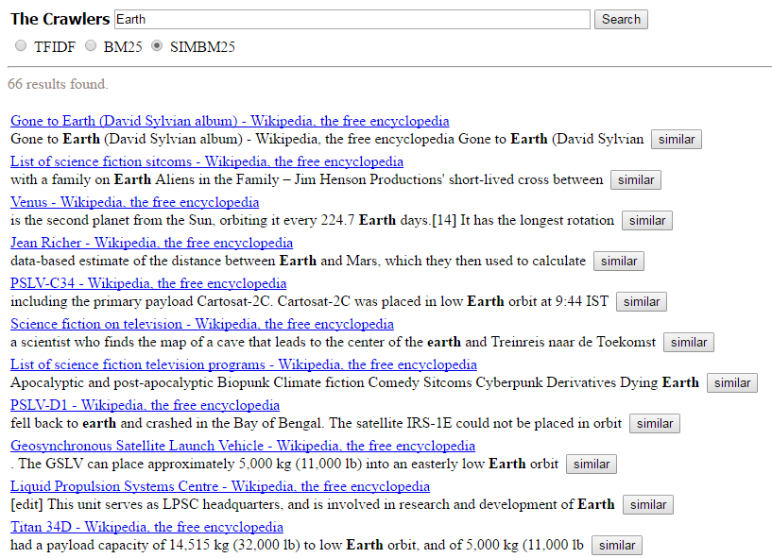
Query: Earth
BM25 Result SIMBM25 Result
BM25:
4/10
SIMBM25:
7/10

Slide 24
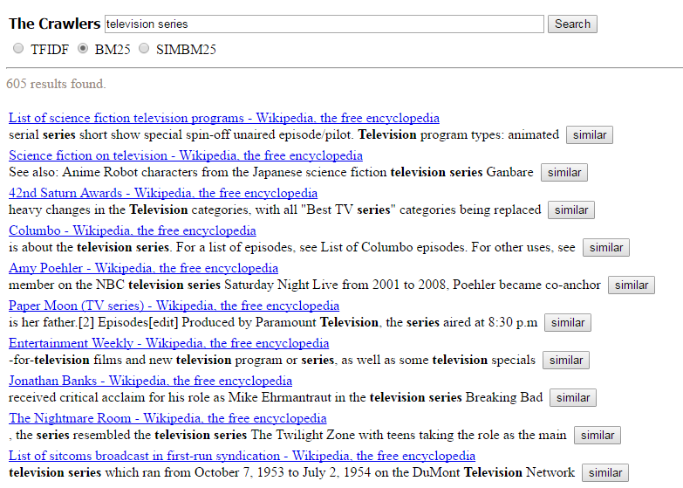
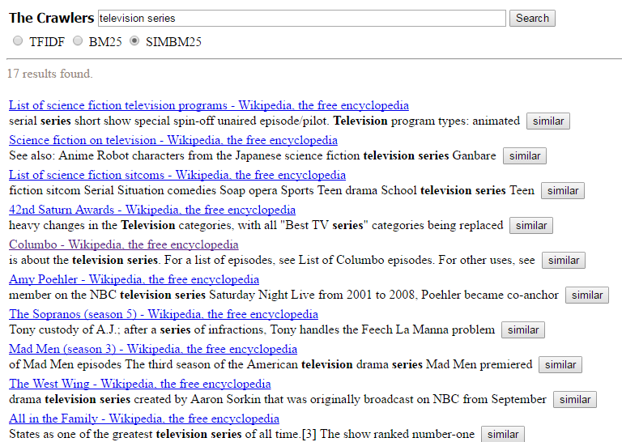
Query: Television Series
BM25 Result SIMBM25 Result
BM25:
5/10
SIMBM25:
8/10

Slide 25
Conclusion
SIMBM25 scoring function is an extension of BM25.
It uses structural contextual information to improve results.
SIMBM25 gives better precision than BM25. In other words, SIMBM25 is at least as good as BM25.
Quality of SIMBM25 depends upon top k results of BM25.
Further scoring can be improved by including similarity of the results and query.
A graph can be built taking nodes as {query, res1, res2,……,resN} and SimRank can be applied to get the similarity value.

Slide 26
Thank You

